Slide 1

Company presentation
7 November 2021

Slide 2

What we do
We extend the commercial life of batteries that would have otherwise entered the recycling network prematurely, we use well-maintained deep cycle lead acid batteries for existing applications and alternative uses. We are constantly seeking new uses and being asked for new applications for which we will require a larger number of batteries.
01 Company presentation
01

Slide 3
What we do
Eventually, once the batteries reach the end of their commercial life, they are retrieved and recycled through a virtuous closed loop process which the lead acid battery achieves an admirable level of efficiency. It is important to stress that to comply with all current battery regulations.
02 Company presentation
01

Slide 4
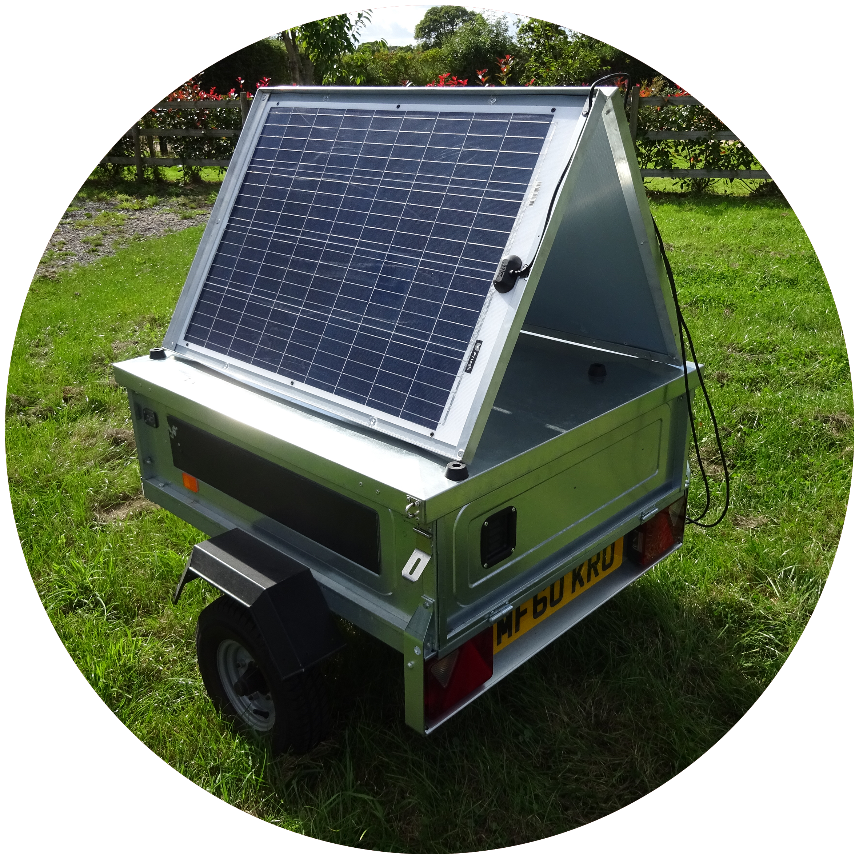
Proving concept
We have already completed independent testing and a feasibility study of this initiative using a selection of quality absorbent glass matt batteries and a third-party technology provider before going on to build our prototype.
03 Company presentation

Slide 5
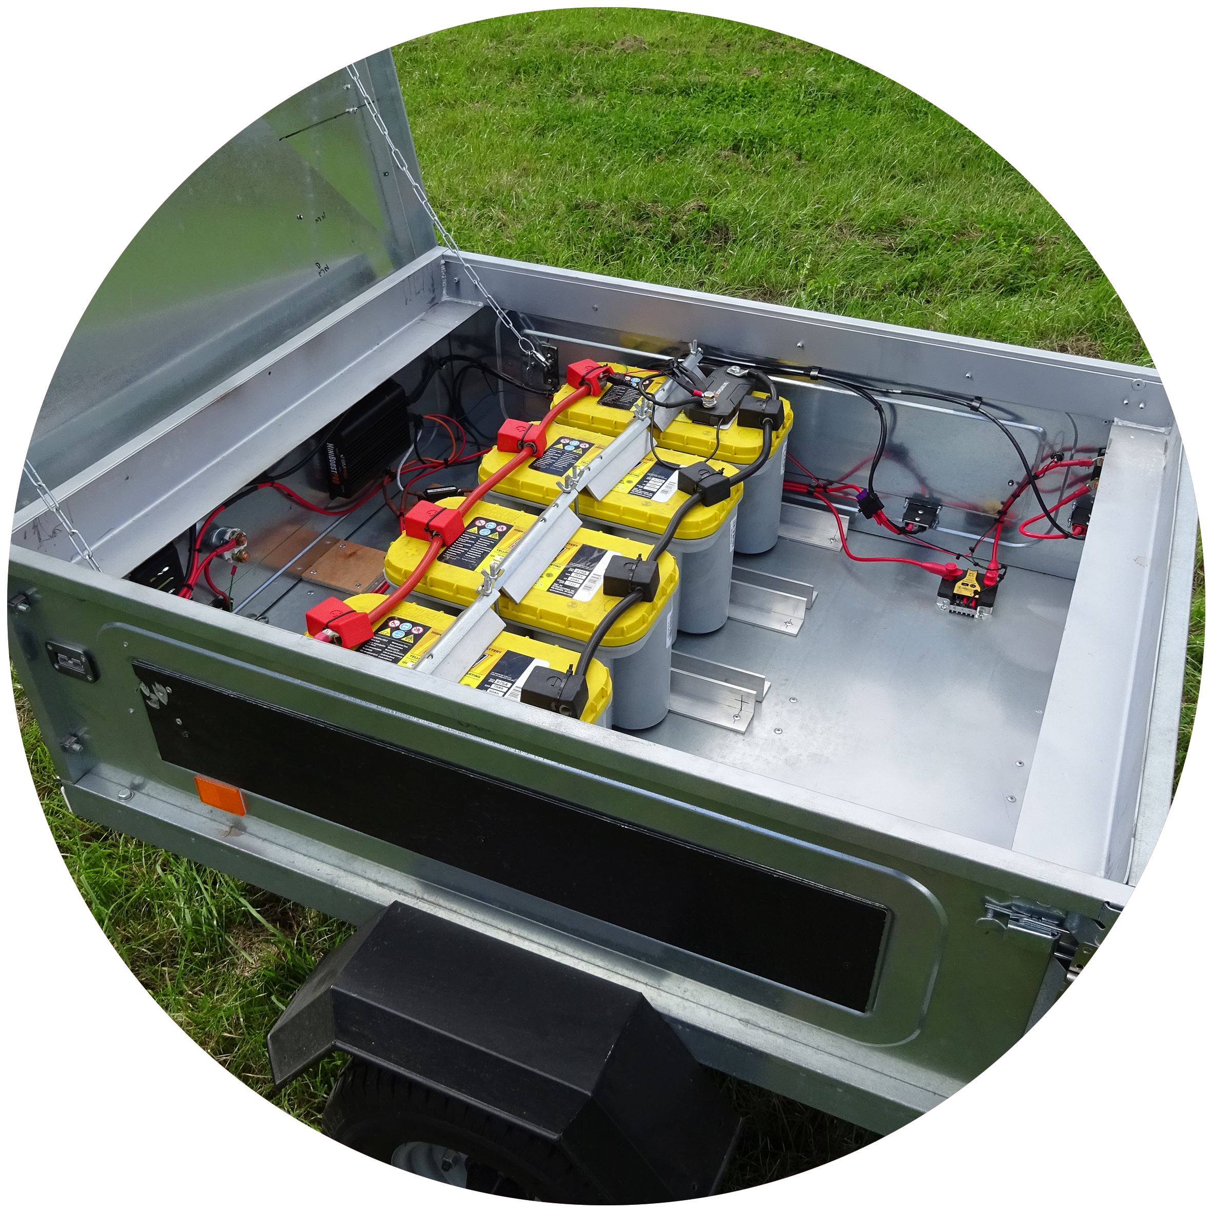
Proving concept
The “phoenix power trailer” is a 3500Wh, fully road legal trailer suited to off grid high quality glamping applications.
The batteries are rechargeable through the 200w collapsible/removable solar array, from your vehicle whilst being towed or even an external battery charger if a feed from the grid is available. It contains Bluetooth monitoring of how much charge you have and the health of the batteries. Low power protection is built in to ensure the battery health is maintained.
04 Company presentation

Slide 6
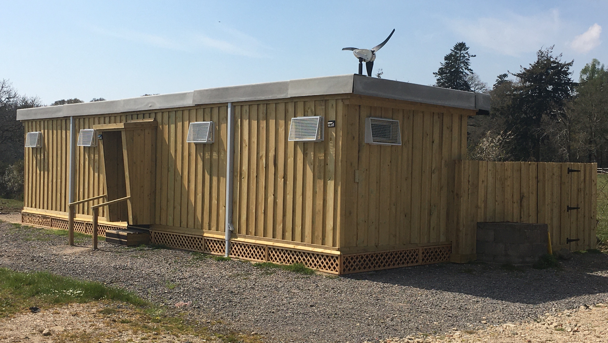
Delivering practical off-grid solutions
Our first independent project was an off-grid power solution for a 40’ welfare and convenience facility at a major county show in the heart of the New Forest National Park. Our 460 amp battery bank is recharged through a mixture of solar and wind generation. This facility now benefits from hot water, full LED lighting throughout and twin banks of USB charging lockers for use by visitors in which to charge their phones and other devices in a secure way.
Delivering practical off-grid solutions
01 Presentation title
05 Company presentation

Slide 7
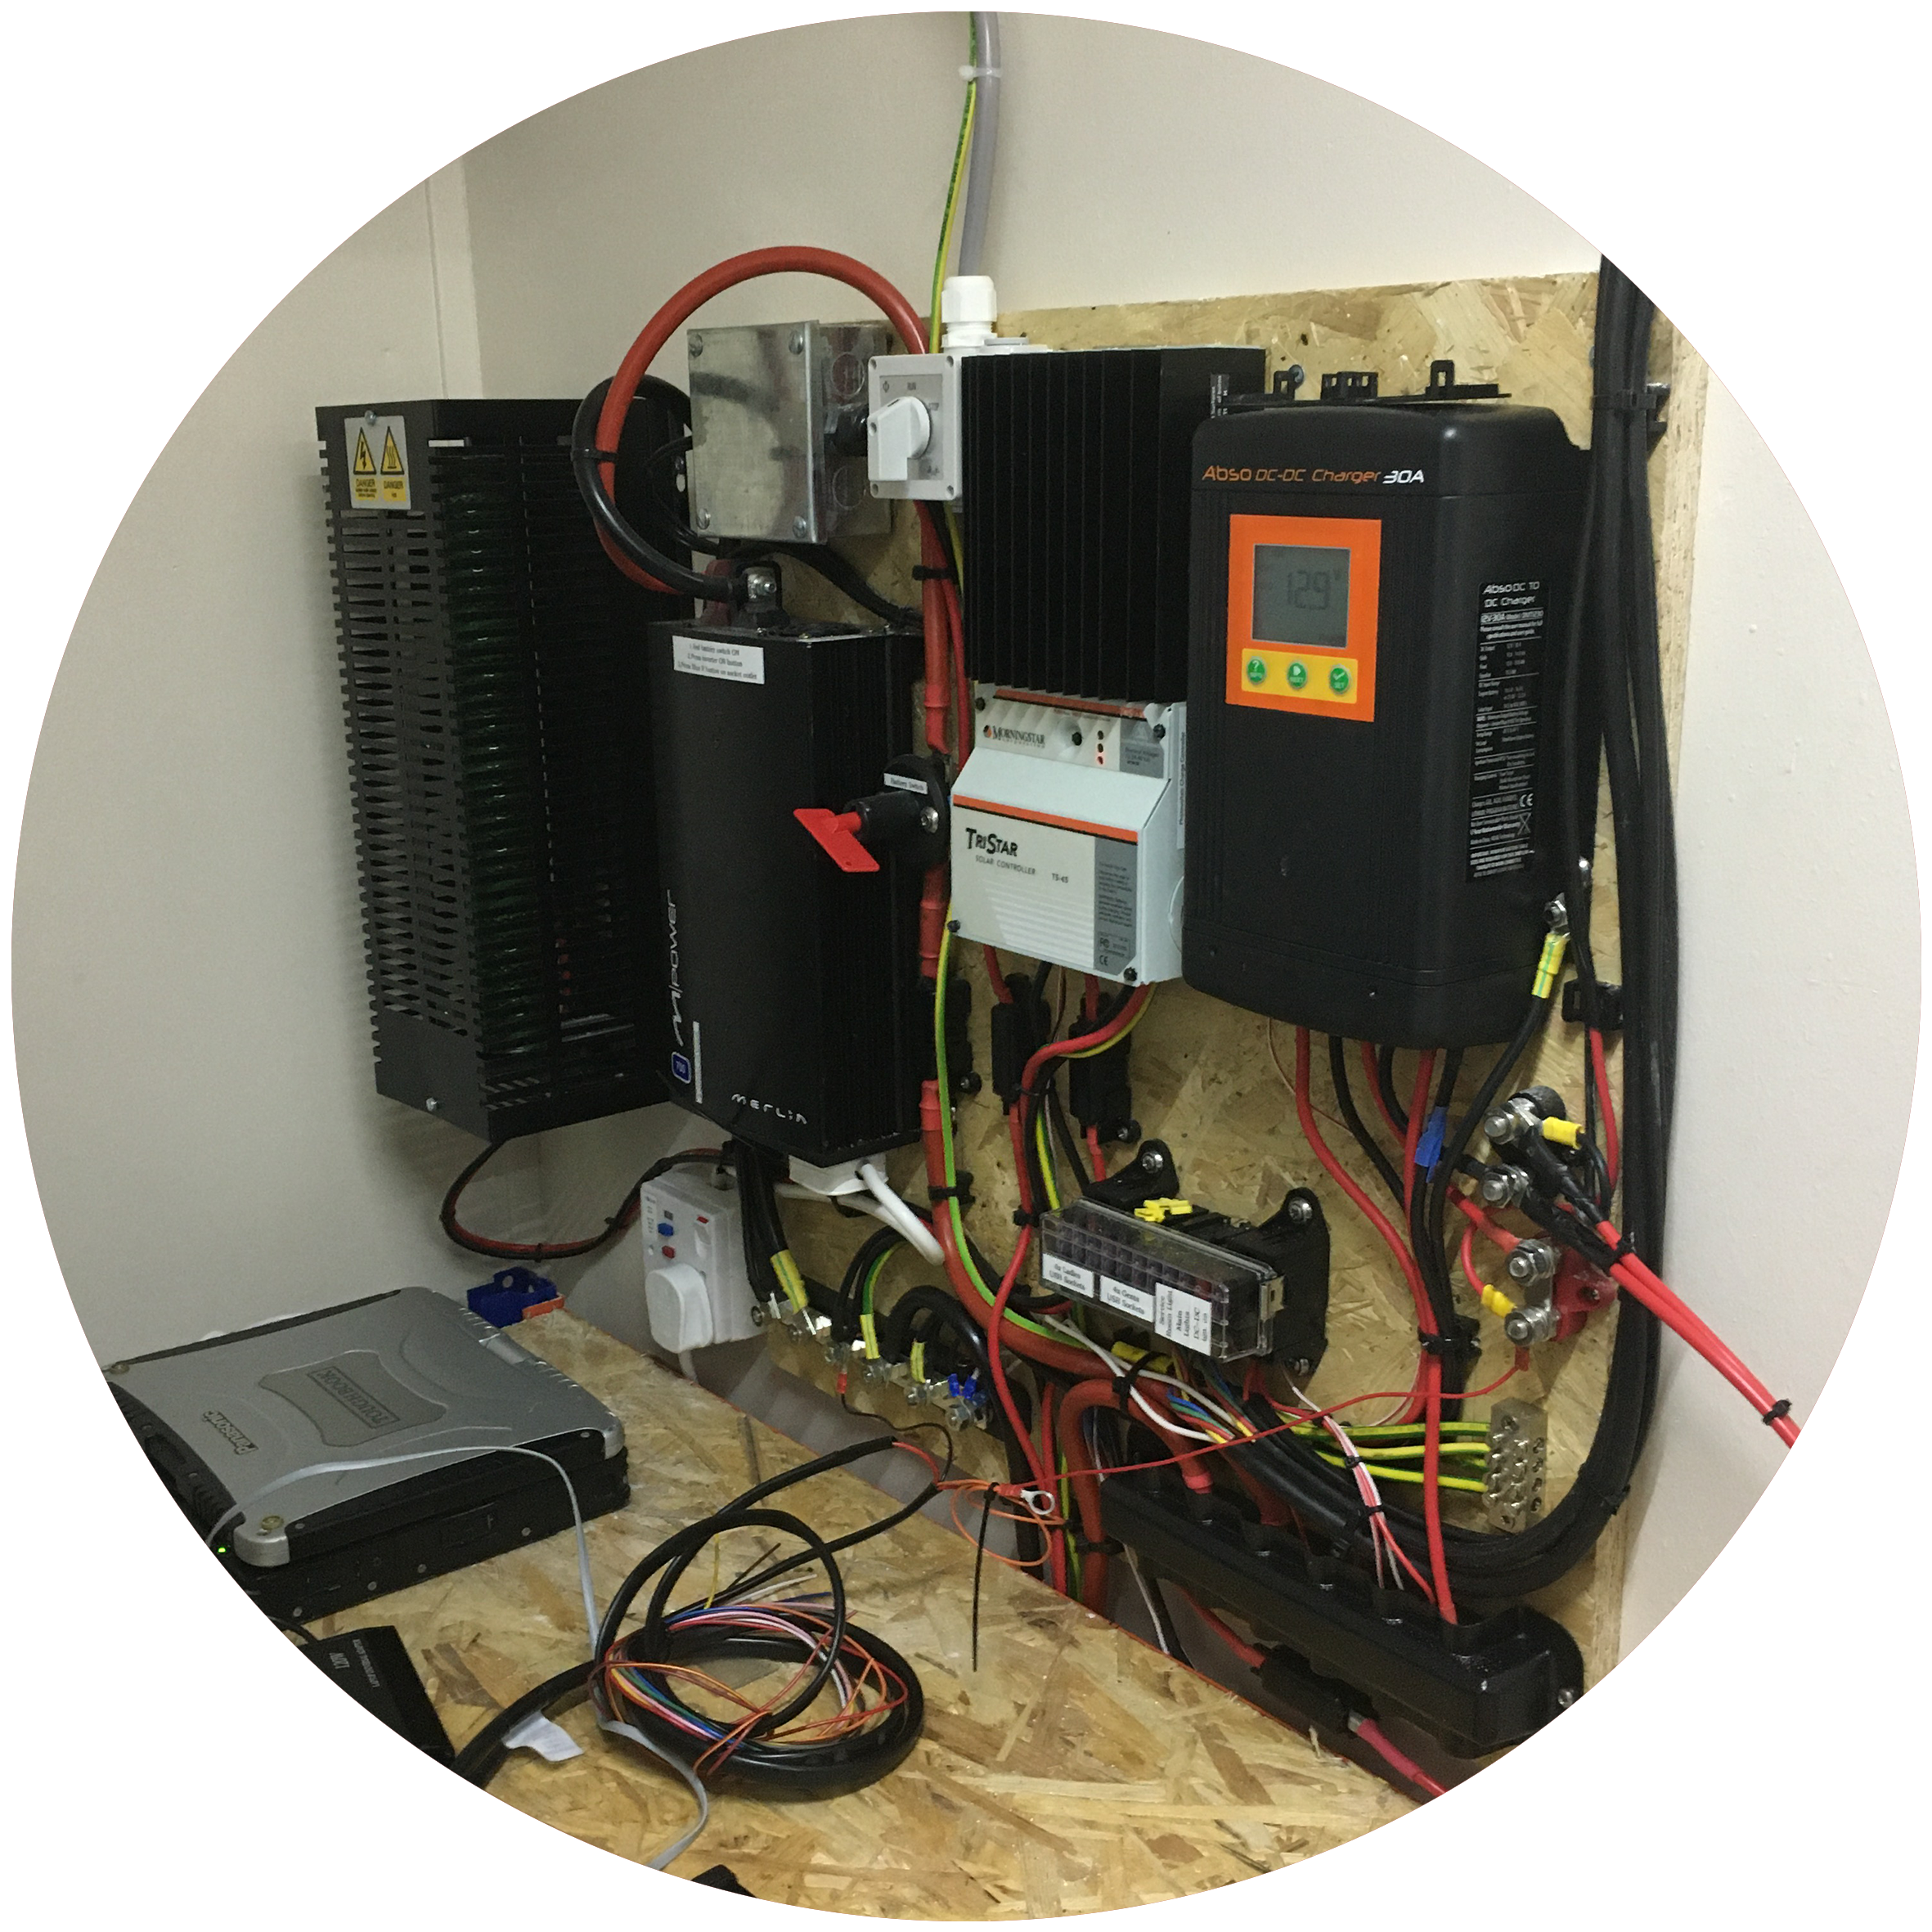
Our first independent project was an off-grid power solution for a 40’ welfare and convenience facility at a major county show in the heart of the New Forest National Park.
Our 460 amp battery bank is recharged through a mixture of solar and wind generation. This facility now benefits from hot water, full LED lighting throughout and twin banks of USB charging lockers for use by visitors in which to charge their phones and other devices in a secure way.
06 Company presentation

Slide 8
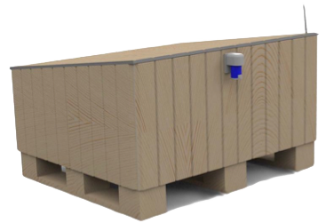
PitchPower
We were approached to see if we could design a solution for a camp site that had reached peak grid power capacity during the day.
We designed a fully recycled pallet solution that provides up to 3,000w of power from a 750Ah battery bank which is then automatically recharged from off peak grid supply. The 100amp charger ensures the used energy is replenished within 4 – 6 hours each night when power consumption is at its lowest. Batteries are remotely monitored and low power protection is fully built in. With dimensions of 1.2m (L) x 1m (W) x 0.5m(H) reducing to 0.35m(H) these are unobtrusive but durable power stores.
07 Company presentation

Slide 9
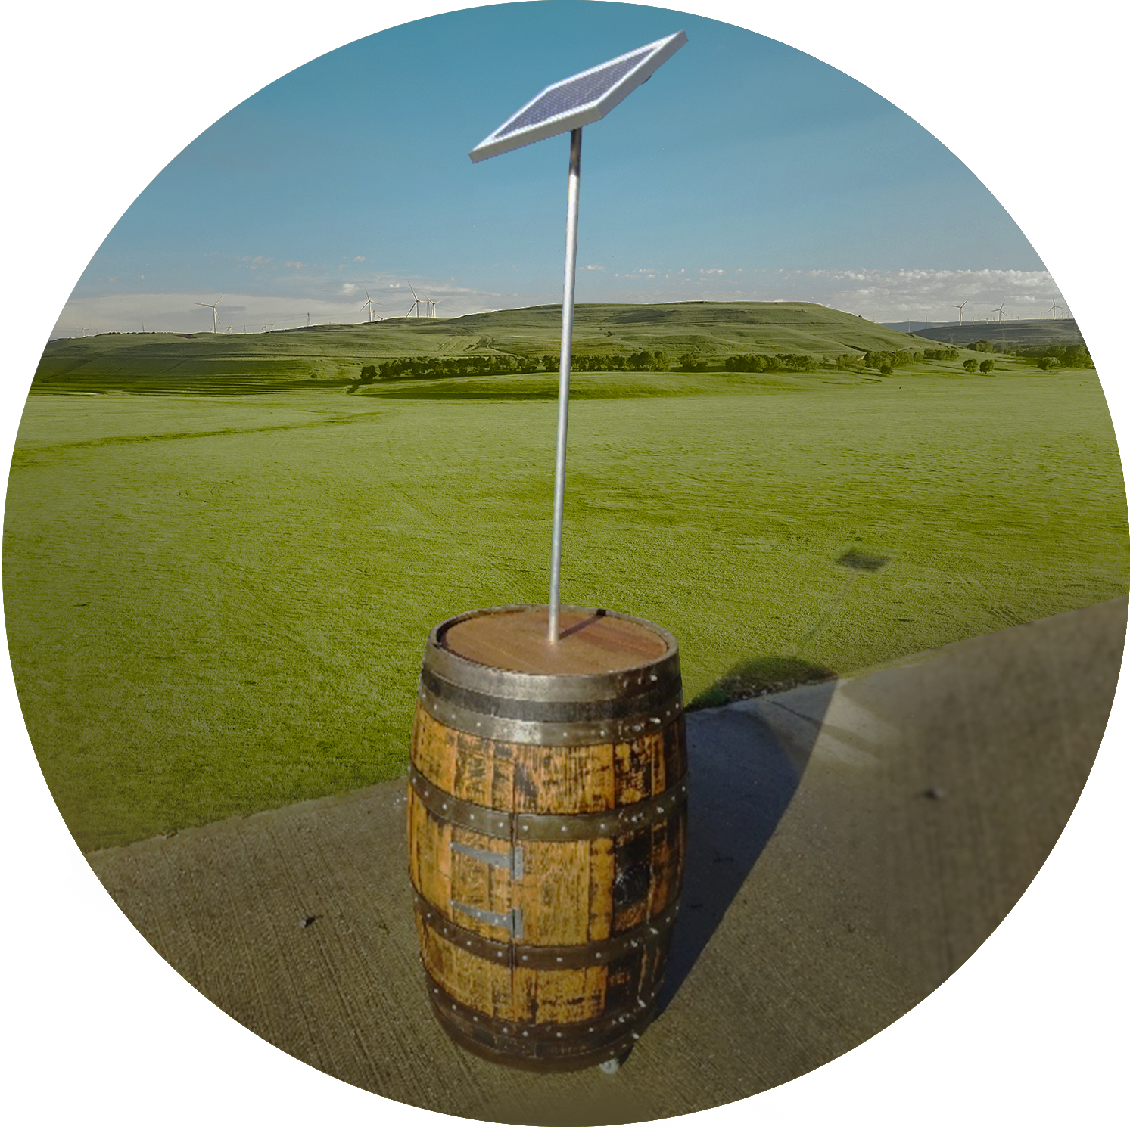
Just for fun
We love a party like everyone else and wondered how we might adopt our reuse initiative, so we came up with the music barrel.
Yes, it’s a former whiskey barrel that now contains solar PV, table top fast charge for your phone, water resistant speakers and Bluetooth adapter. It’s a musical dream all powered from one of our batteries that is recharged by daylight.
08 Company presentation

Slide 10
Going forward we are looking at signage solutions and storage for wind and solar power generation.
09 Company presentation

Slide 11
Does this contribute toward the current environmental agenda?
It is our opinion this extension/alternative use approach fits well within the resource and saving management, circular economy and climate change that are all cited in the green agenda being pursued by Government. Our research also highlighted that because of this unique resource efficiency we would also be in full alignment with the resource-efficient Europe Flagship initiative, centring around sustainable growth via a resource-efficient, low-carbon economy.
10 Company presentation

Slide 12
Our initiative of prolonging battery use is not exclusive to lead batteries, and the ongoing scramble for used Nissan Leaf or Tesla lithium-ion batteries for less demanding power storage is a casing example. We feel that extending the life of any product is crucial for the environment, but people seldom talk about the consequences of using lithium ion.
Lithium ion does not perform well in temperature extremes (especially high or low heat scenarios) and is quite a fragile technology. Some mineral extracts on lithium indicate the carbon footprint and economic damage at production stage dwarfs that of the lead acid equivalent. Mining for lithium is an extremely labour and water intensive process. Mining occurs predominantly in less or undeveloped countries where child labour is prevalent and environmental laws weak or non-existent.
11 Company presentation

Slide 13
The most serious issue surrounding lithium Ion technology is what happens to the toxic heavy metals included in lithium batteries at the end of its life, namely cobalt, nickel and manganese. There is not currently a solution for this, and some say it’s too early, however there are articles implying that Panasonic and Tesla are working toward a solution that will avoid the need for Cobalt in their future battery technology. Time will tell if they are successful, but in the meantime we would like to prolong and extend the life of proven technologies in lead by our various initiatives.
12 Company presentation

Slide 14
Company registered in England 13030248
Registered address: Shakers Place, Vaggs Lane, New Forest,Hampshire, SO41 0FP
Tel: 01425 205 488
www.lndtech.co.uk

